Slide 1
Lab 1, presentation
Carlo Saccardi
Filip Zawadka

Slide 2
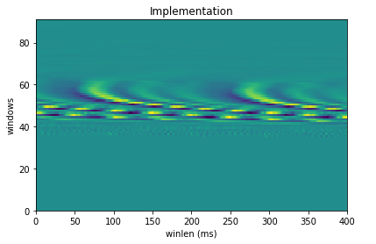
QUESTION 4.1: Enframe
An audio signal is constantly changing, so to simplify things we assume that on short time scales the audio signal doesn't change much (when we say it doesn't change, we mean statistically i.e. statistically stationary, obviously the samples are constantly changing on even short time scales). This is why we frame the signal into 20ms frames.
The sampling rate is equal to 20000, which means that for each seconds 20000 'points' are sampled. If we consider a window that is 20 milliseconds long (20/1000 seconds long), then the number of samples in that window will be equal to: sampling_rate * winlen. Same logic for the shift.

Slide 3
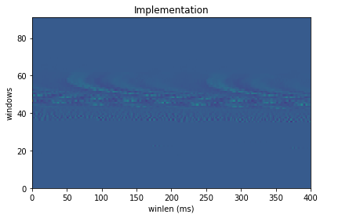
QUESTION 4.2: Pre - emphasis
This step increases the amplitude of high frequency bands and decrease the amplitudes of lower bands. Thus, it is helpful to deal with noise.
Explain how you defined the filter coefficients.
The function lfilter from scipy.signal takes parameters b, a, and x into account scipy.signal.lfilter(b, a, x) and dose the following:
a[0]y[n] = b[0]x[n] + b[1]x[n-1] + ... + b[M]x[n-M]
Since we want to compute y[n]=x[n] -αx[n-1], we can set a=1 and b = (1, -p)

Slide 4
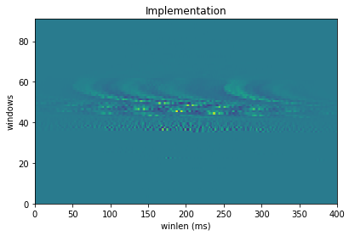
QUESTION 4.3: Hamming - Window
Why this windowing should be applied to the frames of speech signal:
If we take the Fourier transform of rectangular windows that we otained in the previous steps, we will obtain very high sidelobes. Thus, it is better to apply a Hamming window that do not have a constant value of 1 for each point in the window function. the fourier transform in this case will be smooter, with very little sidelobes. A disadvantage of this function is that the main lobe will be a bit wider.

Slide 5
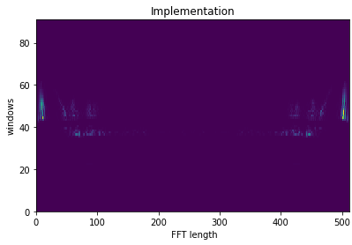
QUESTION 4.4: Fast Fourier Transform
When we do the Fourier transform of a time domain signal we obtain a spectrum. Thus, we move from time domain to frequency domain. Then, we consider the power spectrum to avoid complex numbers.
What is fmax in this case according to the Sampling Theorem?
Assuming that the highest frequency component for a given analog signal is fmax, according to the Sampling Theorem, the sampling rate should be at least 2×fmax.
Thus, since the sampling rate is equal to 20000, fmax = 10000

Slide 6
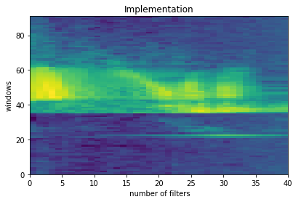
QUESTION 4.5: Mel filterbank log spectrum
Describe the distribution of the filters along the frequency axis.
The Mel-scale aims to mimic the non-linear human ear perception of sound, by being more discriminative at lower frequencies and less discriminative at higher frequencies. Each filter in the filter bank is triangular and has a response of 1 at the center frequency and decrease linearly towards 0 till it reaches the center frequencies of the previous and following filters where the response is 0.
The traingles tend to be very narrow for lower frequency but, as the frequencies get higher our filters get wider as we don’t care much about these variations

Slide 7
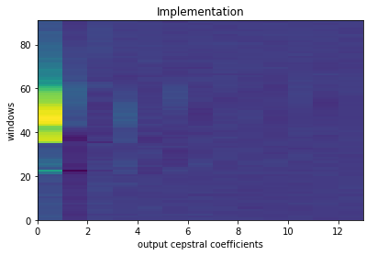
QUESTION 4.6: Cosine Transform and Liftering
It turns out that filter bank coefficients computed in the previous step are highly correlated, which could be problematic in some machine learning algorithms. Therefore, we can apply Discrete Cosine Transform (DCT) to decorrelate the filter bank coefficients and yield a compressed representation of the filterbanks. Typically, the first cepstral coefficients 2-13 are retained and the rest are discarded. The reasons for discarding the other coefficients is that they represent fast changes in the filter bank coefficients and these fine details are not very informative. We also apply liftering to correct the range of the coefficients.

Slide 8
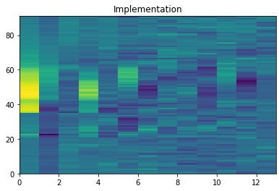
Note that using the n=13 input parameter in dct is not the same as running without the argument and taking the first 13 elements in the results, try to explain why.
In the dct function if the parameter n is lower than the input lenght, then the input is truncated to n --> input[:n], and the transormation is applied on this truncated array. Instead, we want to do the transormation on the intire input, and consider the first n coefficient--> resulting_coefficients[:n]

